Slide 1
NBAC TSC Slides https://github.com/niemopen/nbac-admin/tree/main/nbac-meeting-minutes/25-Jan-2024 25 January 2024 Meeting

Slide 2
25 Jan 2024 NBAC TSC Agenda
1:00 NBAC Co-Chair Opening Remarks – Mr. Kamran Atri, Mr. Thomas Krul
We have re-issued the NBAC TEAMS recurring monthly meeting for 2024
There is a PGB meeting immediately following this NBAC meeting, the readahead is posted at: https://github.com/niemopen/oasis-open-project/tree/main/pgb-meeting-minutes/2024/25-January-2024
Register for NBAC TSC mailing list if you haven’t yet by sending an email to this address: niemopen-nbactsc+subscribe@lists.oasis-open-projects.org
We will dismiss this meeting early to prep for the PGB meeting
1:10 NIEM Management Office (NMO) Update – Ms. Katherine Escobar
Preparing Sub-Committee governance standing document which can be supplemented/replaced by Sub-Committee tailored governance doc as available
Key topics for upcoming PGB meeting

Slide 3
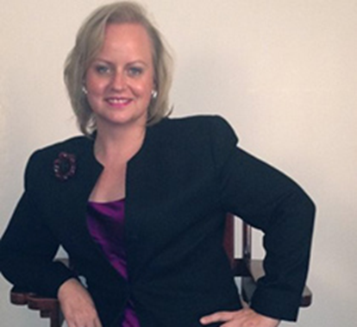
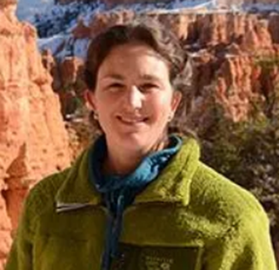
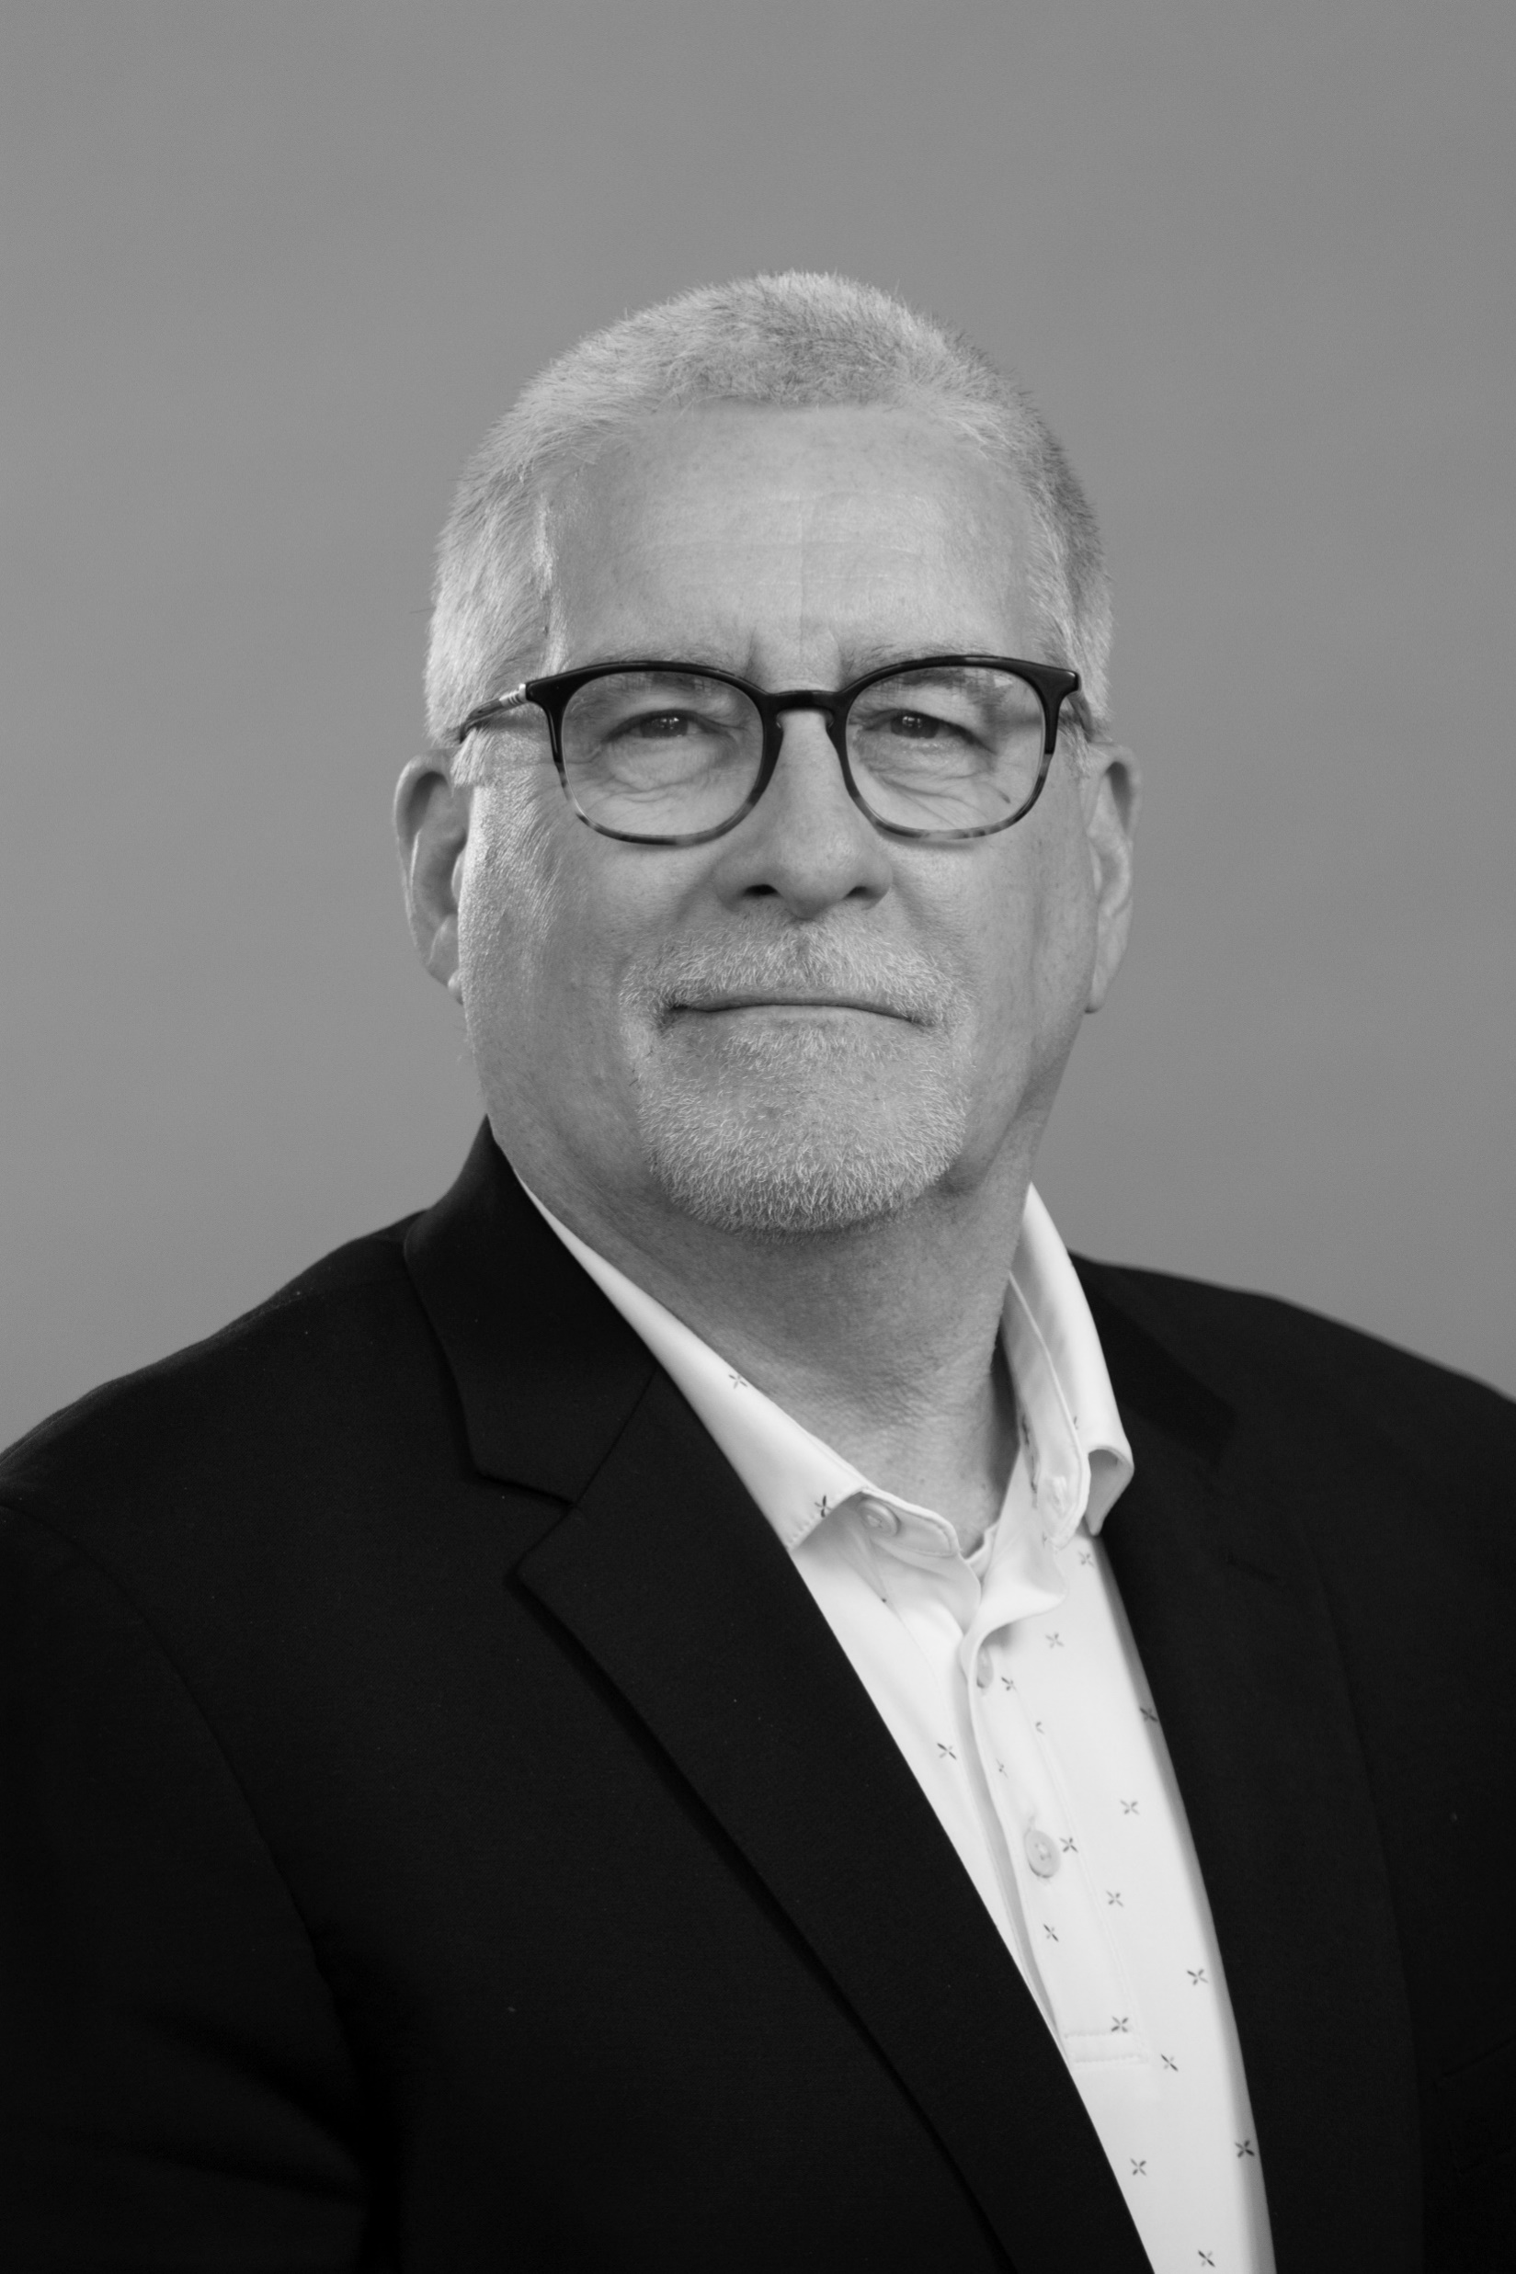
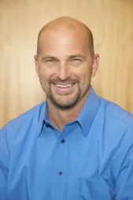
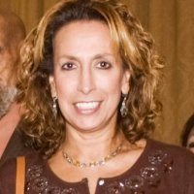
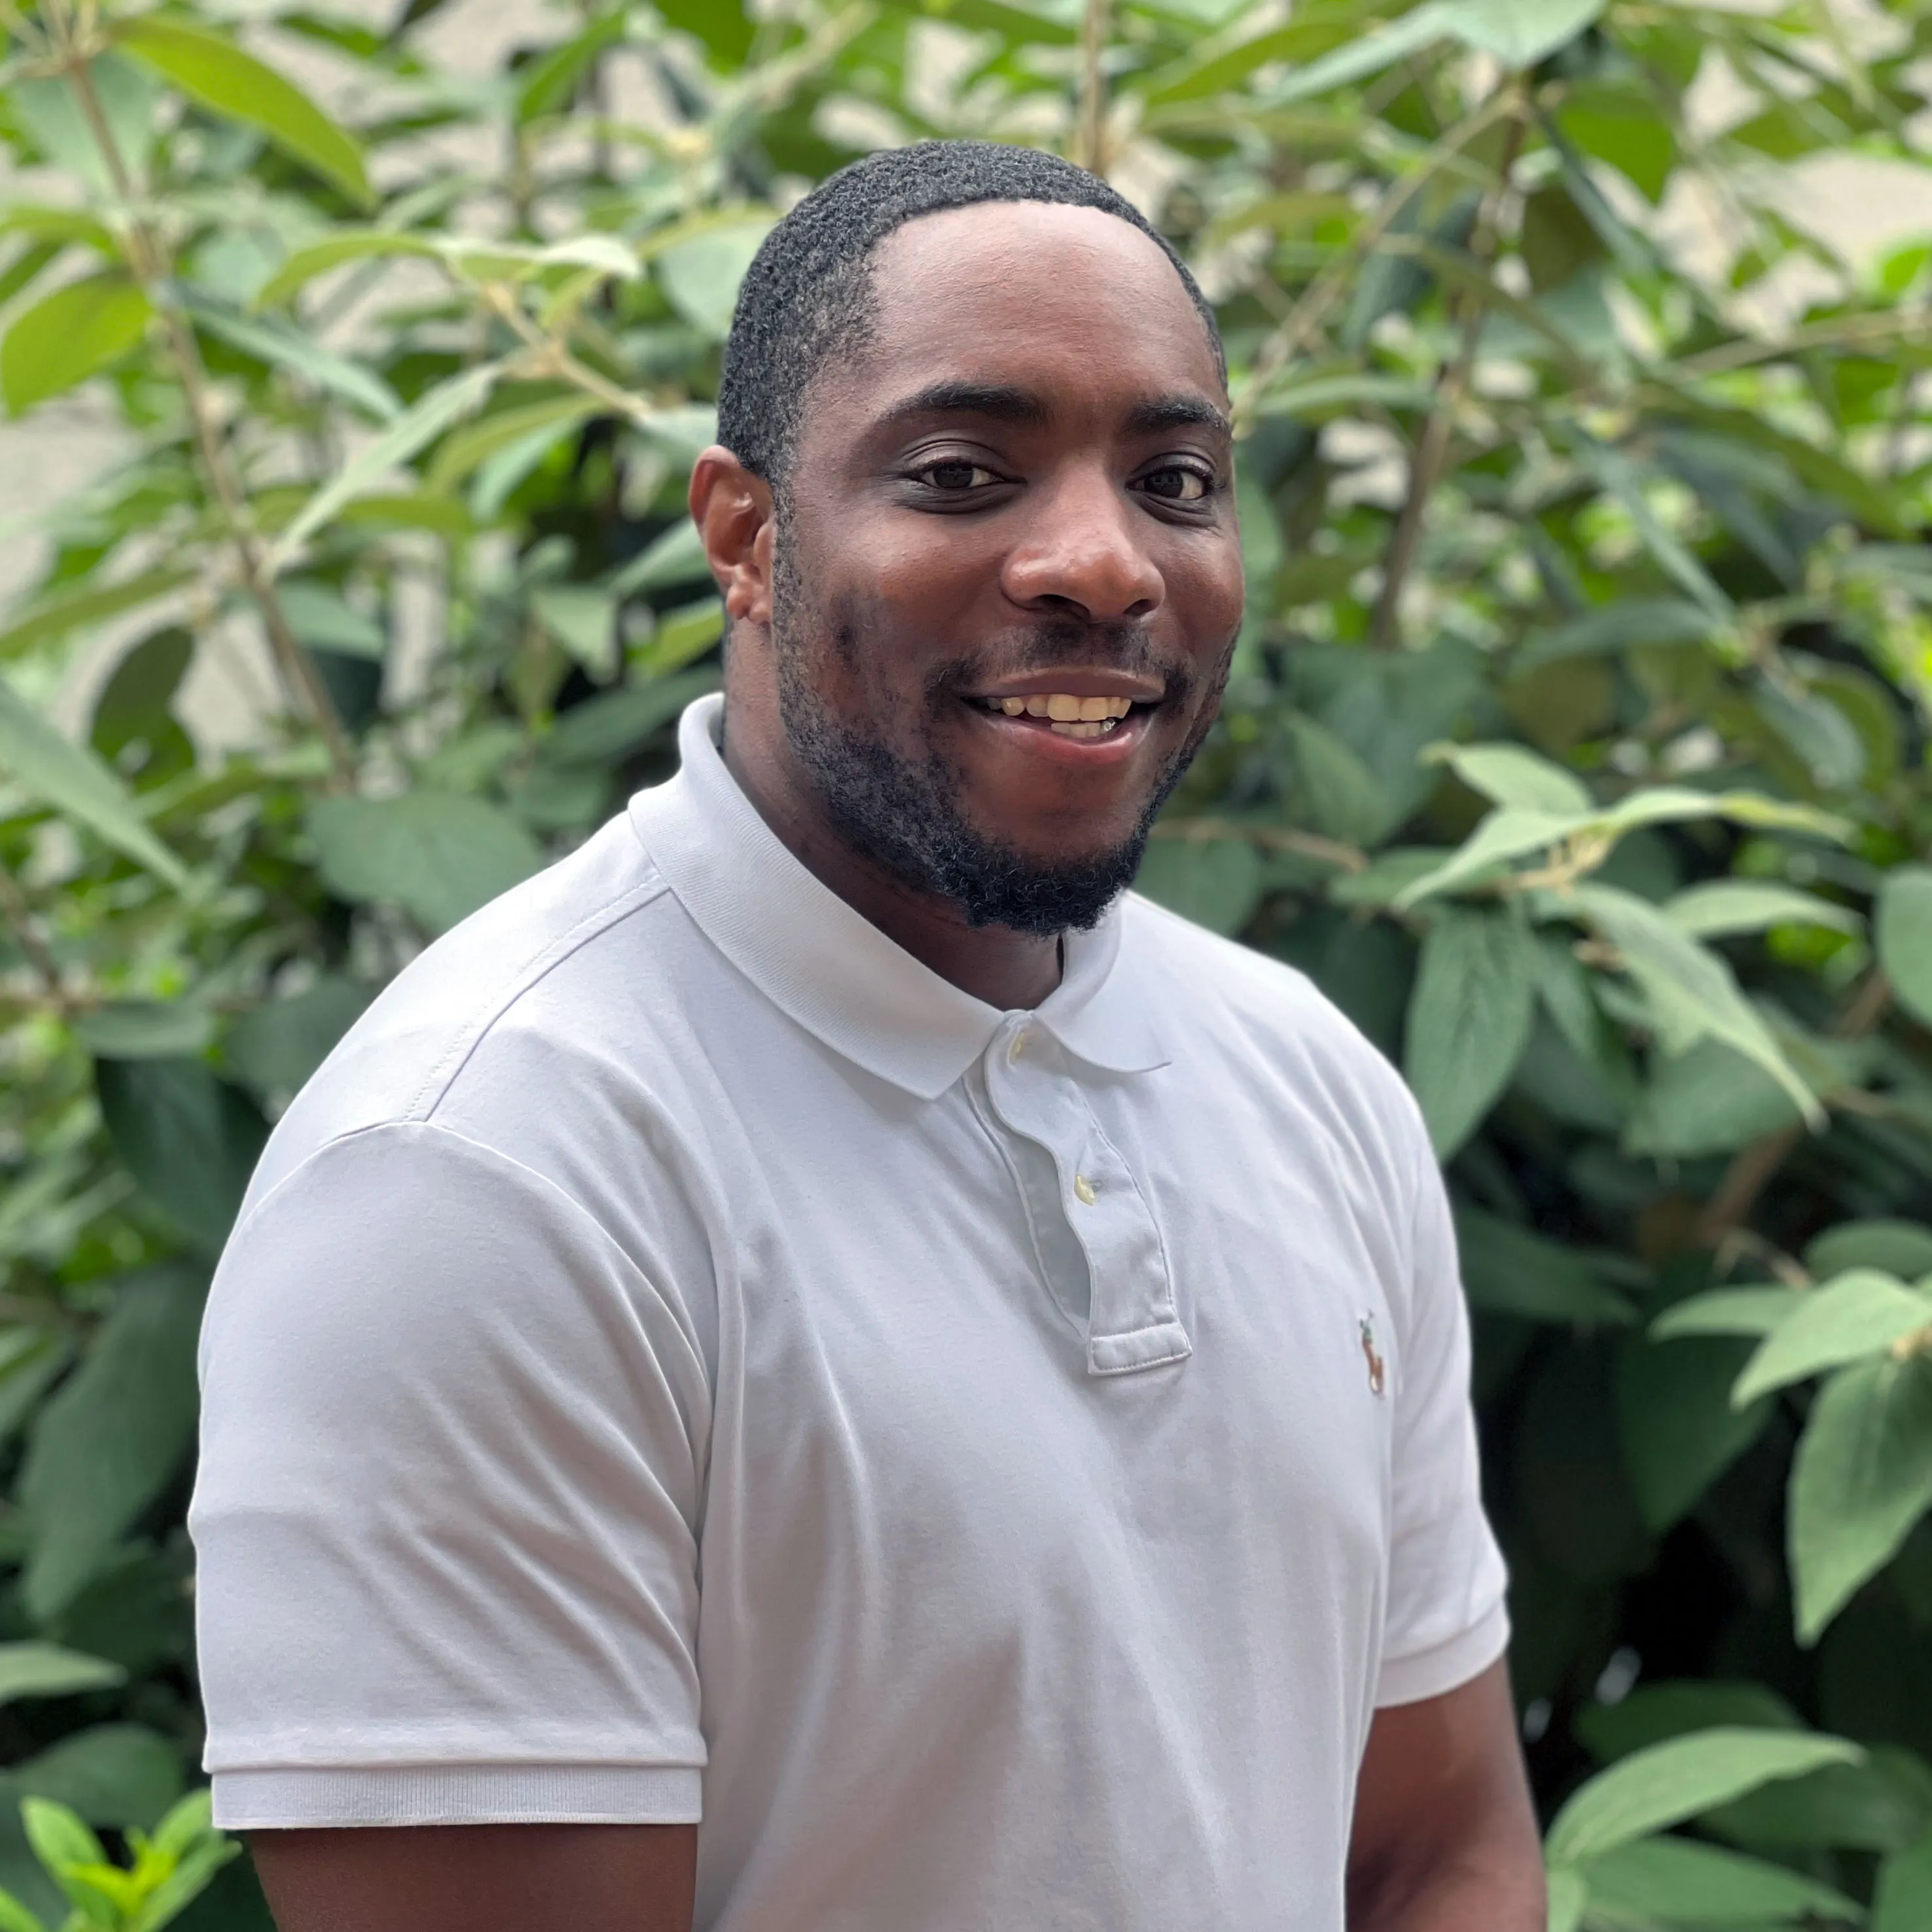
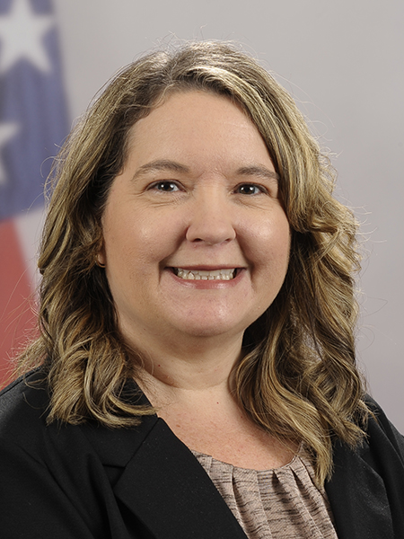







PGB SPONSOR APPOINTED VOTING MEMBERS
Ms. Katherine Escobar
PGB Chair
Deputy Division Chief, Data and Standards Division at Joint Staff J6 and NIEM Managing Director
Ms. Christina Bapst-Stump
Science and Technology Directorate, US Department of Homeland Security
Mr. Gary Egner
Director Business Development, Equivant
Mr. John Wandelt
Principal Research Scientist, Georgia Tech Research Institute
Ms. Maria Cardiellos
Executive Director
Integrated Justice Information Systems Institute
Mr. Payton Lamb
Data Engineer
Commonwealth of Virginia
Office of the secretary of Administration
Office of Data Governance and Analytics
Ms. April Mitchell
FBI It Specialist and Technical Lead of Data Standards in the Criminal Justice Information Services (CJIS) Division
Notes:
Open Project Rules - OASIS Open (oasis-open.org)
5.1 Overall guidance for the Project is provided by its Project Governing Board (or PGB). The PGB is composed of one voting member from each Project Sponsor who elects to appoint a PGB member, and (a) if the PGB has one or more Technical Steering Committees, one voting expert representative from each TSC, elected or appointed by that TSC, or (b) otherwise, the PGB may appoint at least one and no more than two voting expert representatives from its community of contributors. The PGB may create additional non-voting PGB member seats for expert representatives to be elected by the TSC or appointed by the PGB. The PGB membership of all such members of any type is conditioned on satisfaction of the CLA requirement of Section 5.2. Voting status on the PGB may be affected by the provisions of Section 5.7.

Slide 4
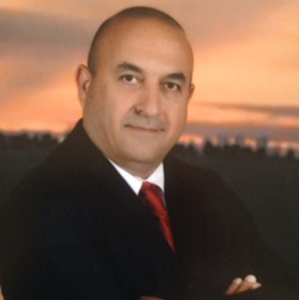
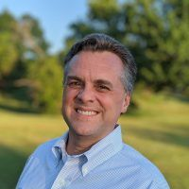
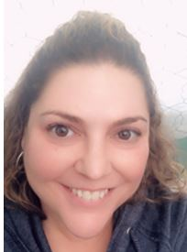
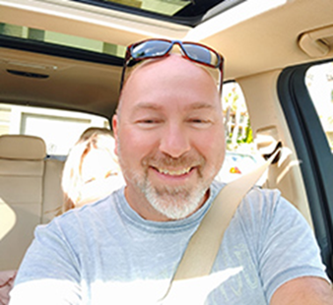

PGB EXPERT VOTING MEMBERS
Technical Steering Committees
Kamran Atri
Co-Chair
NIEM Business Architecture Committee (NBAC) Technical Steering Committee (TSC)
Jim Cabral
Vice President, Court Relations, InfoTrack
Beth Smalley
Co-Chair
NIEM Management Office (NMO) Technical Steering Committee (TSC)
PGB NON-VOTING MEMBERS
Technical Steering Committees
Thomas Krul
Co-Chair
NIEM Business Architecture Committee (NBAC) Technical Steering Committee (TSC)
Dr. Scott Renner
Co-Chair
NIEM Technical Architecture Committee (NTAC) Technical Steering Committee (TSC)
Notes:
We currently have 7 PGB sponsor voting members and 3 TSC PGB expert voting members. Currently 10 PGB Voting Members, 2 PGB Non-Voting Members.
Kamran Atri will represent the NBAC TSC as PGB Expert Voting Member for the next 6 months Jan-July 2024.

Slide 5

NMO, NBAC, & NTAC TSC Co-Chairs
TSC | Approved (TSC CHAIRS)
NMO TSC | Ms. Katherine Escobar & Ms. Beth Smalley
NBAC TSC | Mr. Kamran Atri & Mr. Thomas Krul
NTAC TSC | Dr. Scott Renner & Mr. Jim Cabral
NTAC TSC
Mailing Lists
NIEMOpen: https://lists.oasis-open-projects.org/g/niemopen
PGB: https://lists.oasis-open-projects.org/g/niemopen-pgb
NTAC TSC: https://lists.oasis-open-projects.org/g/niemopen-ntactsc
NBAC TSC: https://lists.oasis-open-projects.org/g/niemopen-nbactsc
NMO TSC: https://lists.oasis-open-projects.org/g/niemopen-nmotsc
NBAC TSC
NMO
TSC

Slide 6
Proposed 25 JAN 2024 PGB Agenda
Call to Order
Admin
TEAMS Link
Meeting Etiquette
Note Takers
Roll Call & Introductions
PGB Voting Members (Sponsors)
PGB Expert Voting Members (TSCs)
PGB Non-Voting Members (TSC Co-Chairs)
TSC Co-Chairs & NIEMOpen Maintainers
Approval of Agenda
Around-the-Horn – PGB Voting Members
Approval of Meeting Minutes from 26 Oct 2023
OASIS Staff / NIEMOpen Administrator Comments
Q3 Financial Snapshot – Cathie Mayo (OASIS)
Sponsor Update – Carol Geyer
CY 2024 Planning
GTRI Contract Update – Mark Dotson
Motions
Approve CY 2024 Q2, 3 & 4 PGB Meeting Dates (Escobar)
5 Minute Break
UPDATES
NTAC Update – Jim Cabral
NBAC Update – Kamran Atri
NIEM Model Version 6.0 PS01 “What’s New” – Christina Medlin
NMO Update – Beth Smalley
Comms & Outreach SC – Paul Wormeli
Software Purchase Costs/ Implementation – Steve Sullivan & Aubrey Beach
Training Stats, STRATCOM & Analytics – Aubrey Beach & Shunda Louis
Next Meeting
Other Business/General Discussion
2025 NIEMOpen Summit Discussion
Motion: Approve summit planning and preparations for 2025 Symposium @ endorsement to commit ~ $40K to secure meeting facilities
Questions/Adjourn

Slide 7

CY 2024 NIEM Open planning
Complete
NIEM Version 6.0 Project Specification (PS01)
Implement EIN Presswire
J6 Complete/contribute MEP tool and host on AWS
Implement LearnPress LMS
Planned/ In Progress
Submit NIEM 6.0 NDR as PSD/ PS
Submit NIEM Model Version 6.0 PS02
Submit NIEM Model Version 6.0 PS02 as an OS
Solicit 3 statements of use
Transfer Training Equities to NMO TSC Training Repo
Update Training Materials to reflect Model Version 6.0 Updates
Update/integrate LearnPress LMS w/Model Version 6.0
Complete NIEM API 2.0
Develop/Complete NIEM Model Version 6.1
Submit NIEM Model Version 6.1 as Open Project Release
Complete/contribute CMF tool
Complete transfer of github.io files to NIEMOpen
Execute 2025 NIEMOpen Symposium
To Be Accomplished 2024!
Submit NIEM 6.0 NDR as PSD/ PS
Submit NIEM Model Version 6.0 PS02
Submit NIEM Model Version 6.0 PS02 as an OS
Solicit 3 statements of use
Transfer Training Equities to NMO TSC Training Repo
Update Training Materials to reflect Model Version 6.0 Updates
Update/integrate LearnPress LMS w/Model Version 6.0
Complete NIEM API 2.0
Develop/Complete NIEM Model Version 6.1
Submit NIEM Model Version 6.1 as Open Project Release
Complete/contribute CMF tool
Complete transfer of github.io files to NIEMOpen
Recurring/On-Going
Identify Potential Sponsors/Conduct Outreach
Populate OASIS Jira & Confluence Site
Conduct Monthly Synch w/ OASIS Staff
Obtain Contributor License Agreements
Bi-Weekly synch with 2025 Symposium Planning Team

Slide 8
NBAC TSC Update
Update NIEM MODEL Version 6.0 PSO1 TO PS02 correcting Issue #96
Obtain 3 Statements-of-Use for NIEM Model 6.0
Advance NIEM Model Version 6.0 PS02 to OS
NBAC TSC Continues to Encourage Sub-Committee Submission of CLAs and Governance Documents
Continue to engage the Department of National Defence (DND) (Canada) to encourage DND adoption of the NIEM Model and consider NIEMOpen Sponsorship
Support NIEMOpen 2025 Summit efforts

Slide 9
NIEM MODEL Version 6.0 PS01 “what’s new”
Updates to support upcoming [NIEM-NDR-v6.0] changes, including:
Adapter changes - New representation terms and a simpler type syntax
Attribute augmentations - semantically-named attribute
Attribute wildcards - Allows declared attributes to be added to any NIEM element property
Metadata changes - Now treated like regular objects
Role changes - Leverages standard type extension and the existing `structures:uri`
Updates related to new digital identity requirements led by the Emergency Management domain
Code set updates, including:
Updates provided by the FBI for the National Crime Information Center (NCIC) codes
GENC codes, version 3-12
PS02 correction needed to redress Issue #96
SimpleObjectAttributeGroup, AdapterType, AugmentationType, and ObjectType requires correction:
Update schemas to reflect PS02
<xs:attribute ref="structures:appliesToParent"/>
<xs:attribute ref="structures:id" />
<xs:attribute ref="structures:ref" /> <xs:attribute ref="structures:uri" />
<xs:anyAttribute processContents="strict" namespace="##other" />

Slide 10
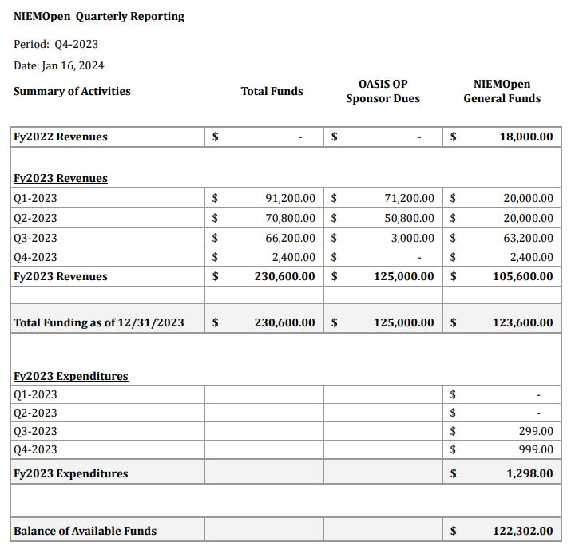
Financials - tabular

Slide 11
25 Jan 2024 NBAC TSC Agenda
1:20 NTAC Update – Mr. Jim Cabral
1:25 Communications & Outreach NMO Sub-Committee update – Paul Wormeli
1:35 Questions/Final Remarks

Slide 12








resources
Follow Us On Twitter
https://twitter.com/NIEMconnects?ref_src=twsrc%5Etfw
Katherine Escobar, katherine.b.escobar.civ@mail.mil, 7575-203-8631
Beth Smalley, beth.l.smalley.civ@mail.mil, 757-203-7177
https://www.niem.gov/
https://niemopen.org/
https://www.linkedin.com/groups/1903175/profile
Git Repos
NIEMOpen: https://github.com/niemopen/
NTAC TSC
https://github.com/niemopen/ntac-admin
NBAC TSC
https://github.com/niemopen/nbac-admin
NMO TSC
https://github.com/niemopen/nmo-admin
https://github.com/niemopen/nmo-training
NIEMOpen Slack Channel: https://niemopen.slack.com/
Mailing Lists
NIEMOpen: https://lists.oasis-open-projects.org/g/niemopen
PGB: https://lists.oasis-open-projects.org/g/niemopen-pgb
NTAC TSC: https://lists.oasis-open-projects.org/g/niemopen-ntactsc
NBAC TSC: https://lists.oasis-open-projects.org/g/niemopen-nbactsc
NMO TSC: https://lists.oasis-open-projects.org/g/niemopen-nmotsc
https://www.youtube.com/channel/UCg9qV22PXLBjG41hc-EwVrQ
MEP Registry & Repository
Restricted Repository-WMAAFIP
NIEM Message Exchange Package Builder

